Slide 1
Devops – CI/CD
23-11-2020 to 27-11-2020
Venkatesh Reddy Madduri && ShankarPrasad

Slide 2

Prerequisites
Familiarity with Linux Commands
Basic knowledge on networking concepts
Target Audience
System administrators
Software developers
Anyone who wants learn !!!

Slide 3
About You
Please tell me about yourself:
Your Name
Your background
What is the purpose of this course?
Where and how you will be using this knowledge?
What do you currently know about DevOps?

Slide 4
About Us
Your Trainers : Venkatesh Reddy Madduri and ShankarPrasad
Experience : 14.5 years and 15 years
Course Organization
Hours : 10:00 to 18:00 hrs
Breaks: As and when required !!
We would be using RedHat 8 as our primary OS and hope every one was able to access their VMs !

Slide 5
Credits
We would like to thank FIS and Training department for giving us opportunity to learn and share our knowledge.
Some of the images/materials may be borrowed from the internet and may not be owned by us. We would like to give the original content authors their due credit.
❖ We extend our gratitude to the original content authors of those images/contents.

Slide 6
Agenda
Day 1: DevOps Overview
Git & GitHub
Day 2: Continuous Integration using Jenkins
Introduction to Docker
Day 3: Kubernetes
Day 4: Ansible
Day 5: Continuous Monitoring using Nagios
Day 5: DevOps Project

Slide 7
What to expect from this training ?
Theory for the first 2 hours on the first day
Later on heavy hands-on
Some theoretical section will obviously be there to explain architecture/concepts

Slide 8
Introduction
For many years, we’ve been finding better ways to build systems
Learning from what has come before - adopting new technologies
Observing how a new wave of technology companies operate in different
Ways to create IT systems that help make both their customers and their own developers happier, eg:
Golang
Docker
Kubernetes
Nginx etc
Few terminologies - these weren’t invented or described before the fact
Domain-driven design
Continuous delivery
On-demand virtualization
Infrastructure automation
Small autonomous teams
Systems at scale

Slide 9
Introduction
Continuous delivery helped to move software into production more effectively & efficiently
Understanding how the Web works led us to develop better ways of having machines talk to each other.
Virtualization allowed us to provision, resize our machines at will (Vagrant, AWS and Azure etc.)
Infrastructure automation - handle these machines at scale(Terraform, AWS CloudFormation, OpsWorks )
Successful organizations like Amazon and Google belief the view of small teams owning the full lifecycle of their services
Netflix has shared with us ways of building antifragile systems at a scale that would have been hard to comprehend just 10 years ago
Microservices have emerged from this world as a trend, or a pattern, from real-world use and they exist only because of all that has gone before - Our Mistakes embracing fine-grained, microservice architectures helps
deliver software faster
embrace newer technologies
Microservices give us significantly
more freedom to react and make different decisions
allowing us to respond faster to the change that impacts all of us

Slide 10
Monolith Systems
Monolithic System Architecture - Single Tiered Architecture
Functionally distinguishable aspects like data input and output, data processing, error handling, and the user interface are all interwoven
User interface & data access code are combined into a single program from a single platform
Monolithic applications are
self-contained
independent from other computing applications
Pros:
Everything is running through the same app
Easy to hook up components to those cross-cutting concerns
Performance advantages, - shared-memory access is faster than inter-process communication
Over time - better architectural patterns have been introduced to the monolithic model to add significant flexibility into the architecture

Slide 11
Monolith Systems Cons
Majority of logic is deployed and runs in a centralized server - SPOF
Typically large & built by big/multiple teams with a large code base
More effort for orchestration between teams for any change/deployment
Difficult for developers to become familiar with the code
Especially a new member to the team
Causes developers to be less productive
Discourages attempts to make changes
Update/small change to a component, entire application to be redeployed
Large effort is required to run regression test against the untouched parts
Dependency on one technology stack
Less flexibility for migration to other tools etc.

Slide 12
The Solution
Migration to microservice architecture from monolithic applications:
Smaller code base
Easy to develop
Adding new features quickly
Fast shipping
Easy to scale certain parts of application

Slide 13
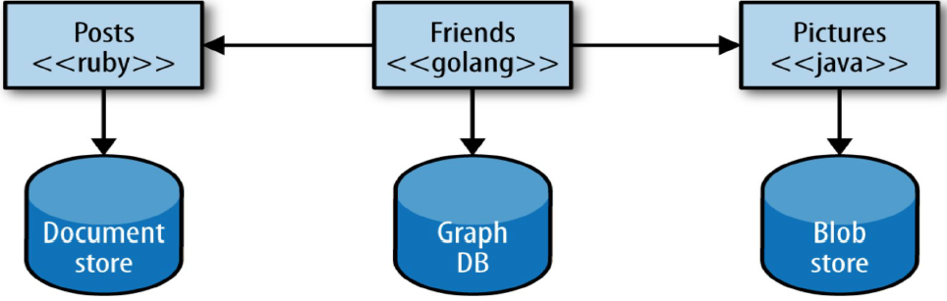
The Solution
Microservices also usage of latest tools & technologies to achieve:
flexibility in design/architecture
Better source code management
Achieve High availability of services
Ease of Deployments
Automation to handle the scale of servers/services
Communication between services/components happen via REST API’s or MQ solutions.
Cohesion : related behavior together
Coupling : change in one product/service should not impact others

Slide 14
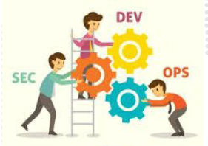
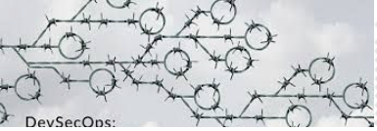
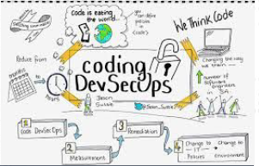
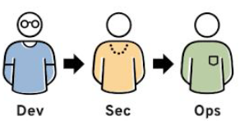
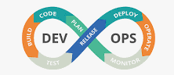
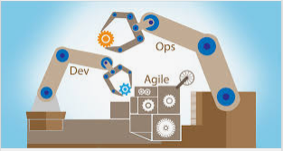
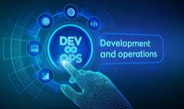


Slide 15
DevOps
We can’t think about microservices without DevOps!!
Microservices cause an explosion of moving parts and not a good idea to
attempt to implement microservices without serious deployment and monitoring automation.
We should be able to click a button and get our app deployed. In fact, we should not even do anything!!
Committing code should get our app deployed through the commit hooks
that trigger the delivery pipelines in at least development
We still need some manual checks and balances for deploying into
production.

Slide 16
DevOps Overview
The DevOps is the combination of two words, one is Development and other is Operations.
DevOps is a culture which promotes collaboration between Development and Operations team to deploy code to production faster in an automated & repeatable way.
DevOps helps to increases an organization’s speed to deliver applications and services. It allows organizations to serve their customers better and compete more strongly in the market which leads following questions.
Why DevOps?
What is DevOps?
DevOps Stages
DevOps Tools

Slide 17

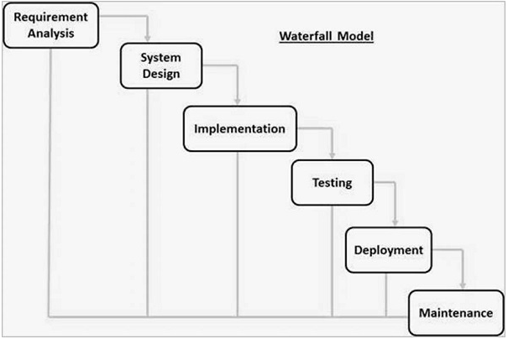
Waterfall Model
Waterfall Model – was the first Process Model. It is also referred to as a linear- sequential life cycle model. It is very simple to understand and use. In a waterfall model, each phase must be completed before the next phase can begin and there is no overlapping in the phases.

Slide 18
Advantages Waterfall Model
Simple and easy to understand and use.
Easy to manage as each phase has specific deliverables and a review process.
Phases are processed and completed one at a time.
Works well for smaller projects where requirements are very well understood.
Process and results are well documented.
Dis-advantages of Waterfall Model
No working software is produced until late during the life cycle.
High amounts of risk uncertainty.
Not a good model for complex and object-oriented projects.
Cannot accommodate changing requirements.
Not suitable for the projects where requirements are at a moderate to high risk of changing.

Slide 19
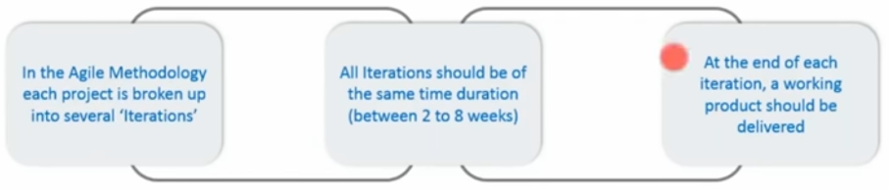
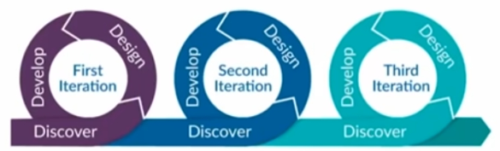
What is Agile Methodology ?
The meaning of Agile is swift or versatile. “Agile process model” refers to a software development approach based on iterative development. Agile methods break tasks into smaller iterations, or parts do not directly involve long term planning

Slide 20
Advantages Agile Methodology
Frequent Delivery
Face-to-Face communication with clients and get feedback on delivered software
Efficient design and fulfils the business requirement.
Anytime changes are acceptable
It reduces total development time.

Slide 21
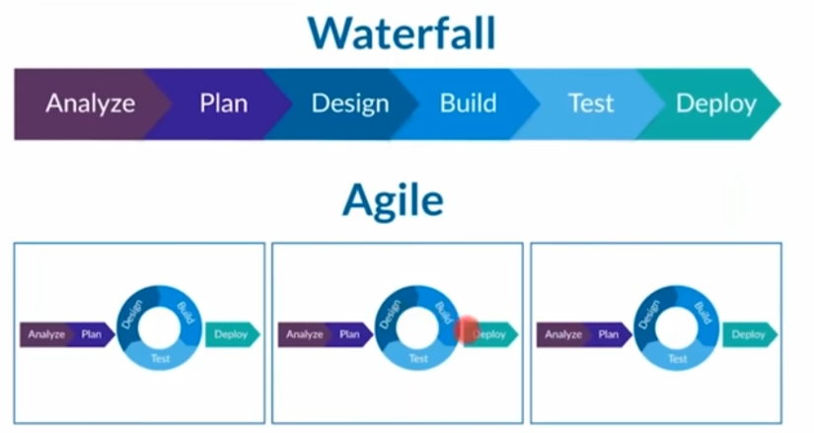
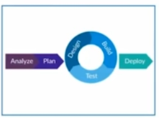
Waterfall Vs Agile
Notes:
Waterfall model is pretty linear and straight, Agile is continuous ( design, build and test continuous) – breaks entire SDLC into small sprints due to which software is delivered continuously.

Slide 22
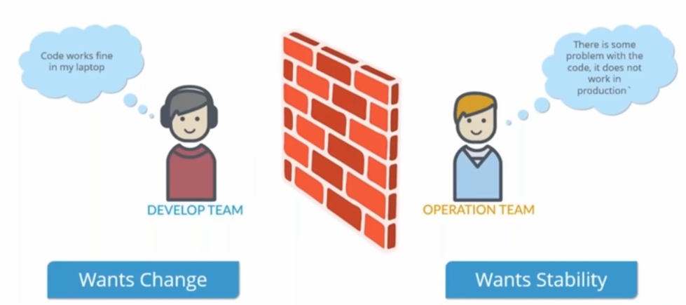
Limitations of Agile
Notes:
Dev is agile ( continuously) , when we talk about deployment it is not happening continuously. Dev wants Change and Ops want Stability.
Code works in my local and it is not working in Production.

Slide 23
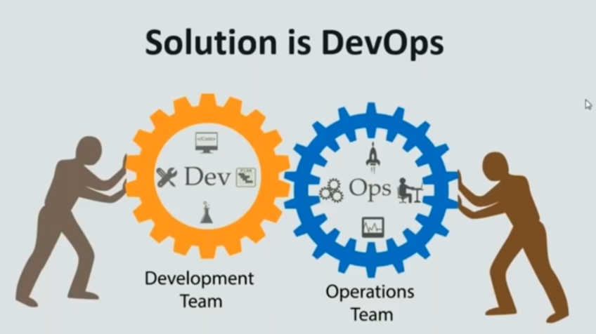
Notes:
SDLC Strategy bridges gap between Dev side and Operations side of company.
It is not a technology rather it is methodology.
Practice dedicated to study of building evolving rapidity changing systems at scale.

Slide 24
DevOps
DevOps commonly includes the following processes:
Agile practices (http://agilemanifesto.org/principles.html)
Continuous integration
Release automation
Functional unit testing
System integration testing
Service and infrastructure monitoring

Slide 25
DevOps Capabilities
Capacity management
How much, big, far
Scalability
Management
Production management
Incident management
Problem resolution
Communication
Monitoring
Telemetry
Logs
Alerting
Problem management
Root cause
Trends, recurring issues
Peer reviews

Slide 26
DevOps Capabilities
Change management
Provisioning New/Updates
Configuration management
Orchestration
Service design
Architecture
Automation
Security
Service management
SLAs and uptime
Costing and budgeting
Metrics and visualization

Slide 27
DevOps Goals
DevOps is about
systems thinking
process definition
team coordination
feedback loops
DevOps is also about continuous improvement
Aims to improve quality and reduce the number of incidents in production
Overall efficiency in the process will increase as the team learns best
practices
Some key improvements are:
Reduce testing time
Reduce the amount of changes required due to incomplete or conflicting requirements
Design the simplest solution required to meet requirements
Leverage standardized integrated software tools
Create robust production systems which lower maintenance costs
Produce software to the highest quality
Improve the performance of individuals and teams

Slide 28
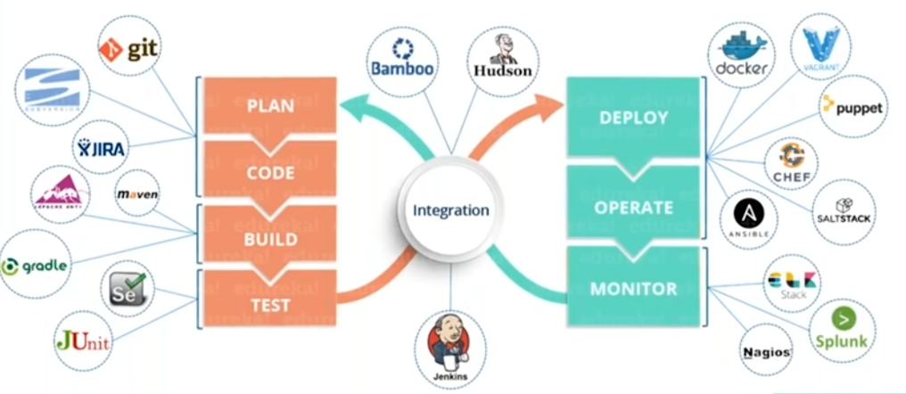
What is DevOps ?
DevOps is a culture which promotes collaboration between Development and Operations team to deploy code to production faster in an automated & repeatable way.
Notes:
DevOps is a practice of Operations and Development engineers participating together in entire software development life cycle from design to development process to production.
Operations staff also uses same techniques as dev teams use for coding. We can further explore in later sections how this is justified.
Infrastructure as a code.
Helps to develop good software in time.
Everything happens continuously (coding to deploy )
Vagrant.

Slide 29
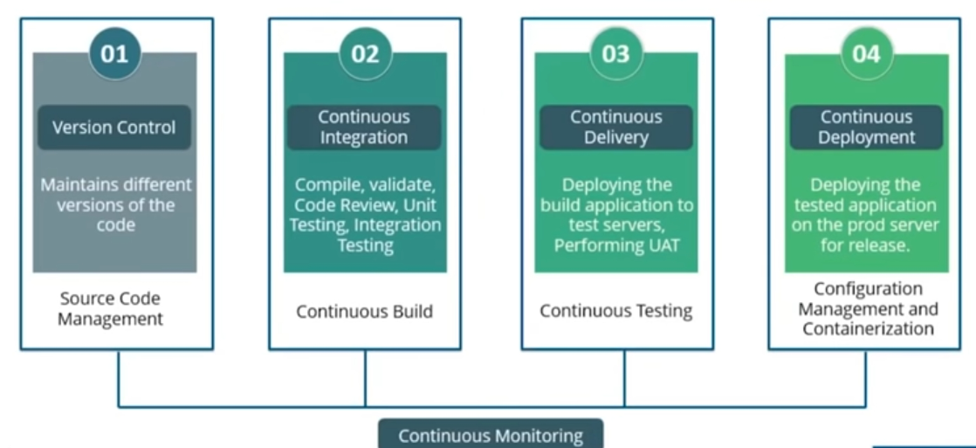
DevOps Stages?
Notes:
Version Control - various develops commits the code and if error occur then it is difficult to find which commit caused issue. Version control gives this option.

Slide 30
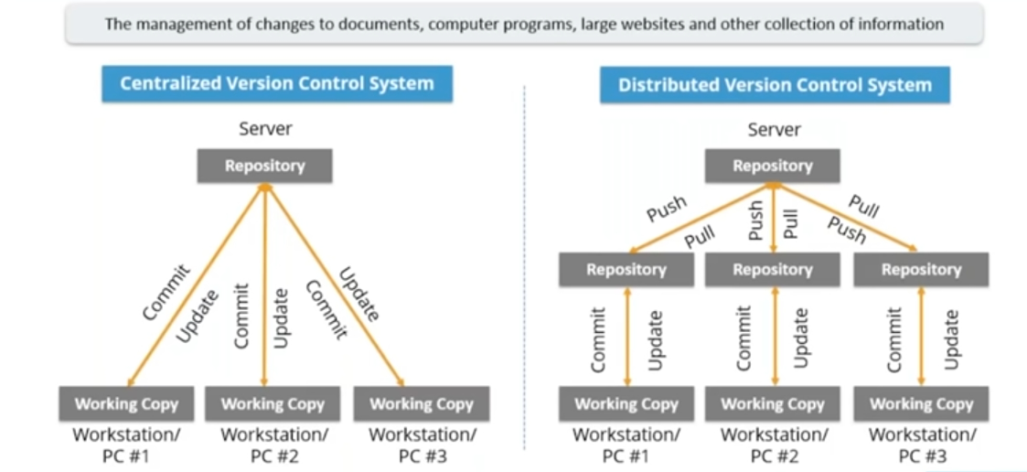
Source Code Management
Notes:
CVCS – Central server stores all the files and uses single repository. All the Operations performed directly into the central servers.
Commit Id and commit msg will be there for each commit. It is not available locally and it requires network connection.
If central server corrupted or crashed then we will losing entire project. Examples : PVCS , SVN
DVCS - Everyone have clone of main repository in their local. They can commit and update local repository anytime without network connection.
If central server crashed, then it will be easy to rebuild as each developer might have full copy of it. Examples Git.
Git is very widely adapted by all companies and we will discuss about Git in following slide.

Slide 31
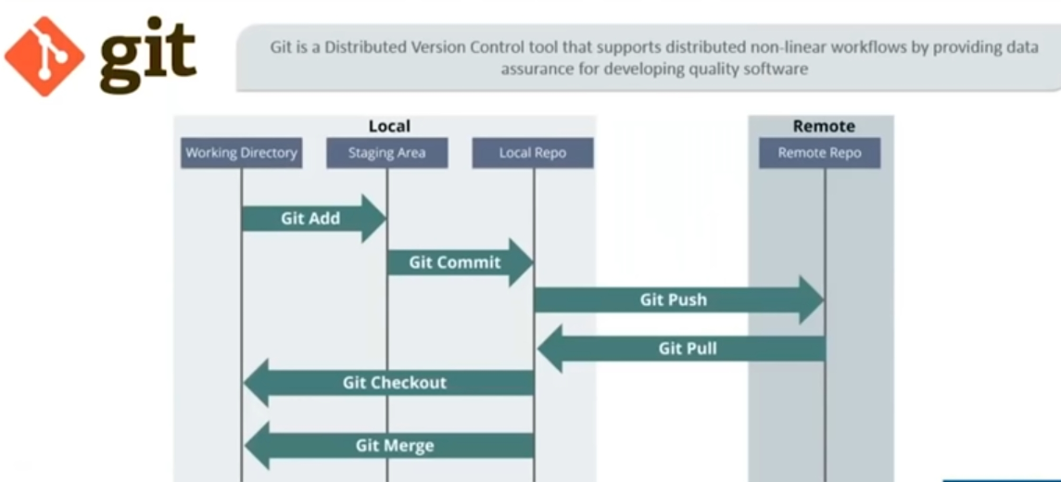
Source Code Management

Slide 32
Source Code Management
git –version
mkdir gitdemo
cd gitdemo
git init
git add filename.ts
git status
git commit –m “demo commit”
git remote add origin git@github.com:gitdemo/gitdemo.git
git pull origin master
git push origin master

Slide 33
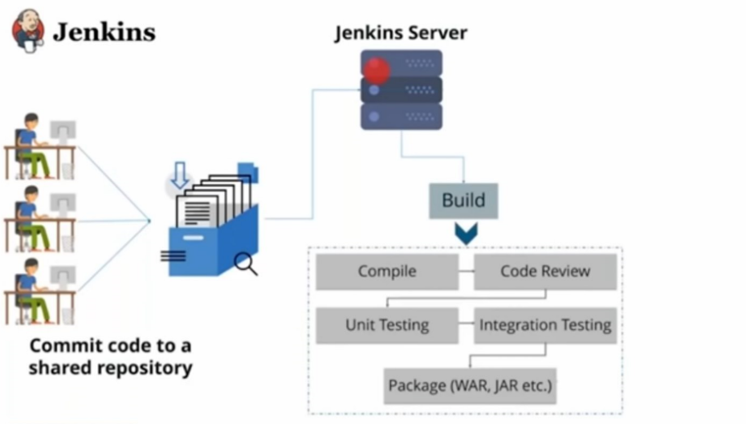
Continuous Integration

Slide 34
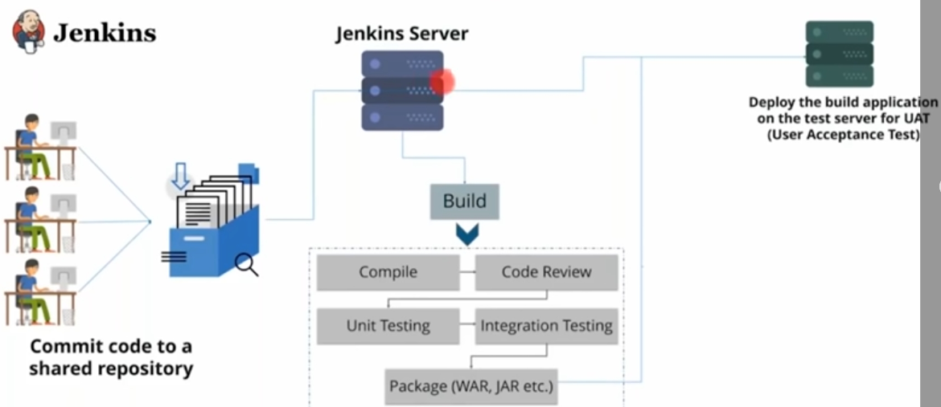
Continuous Delivery

Slide 35
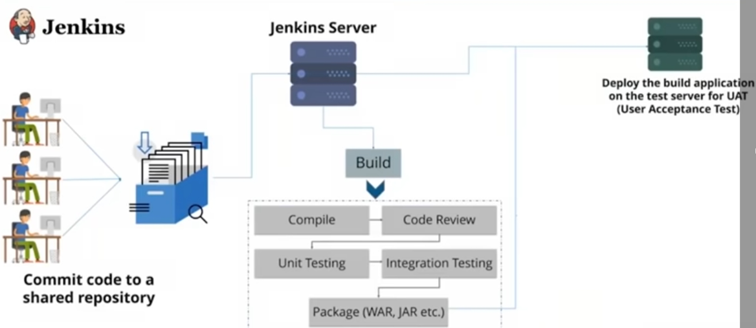
Continuous Delivery
Jenkins is a powerful application that allows continuous integration and continuous delivery of projects, regardless of the platform you are working on. It is a free source that can handle any kind of build or continuous integration. You can integrate Jenkins with a number of testing and deployment technologies.

Slide 36
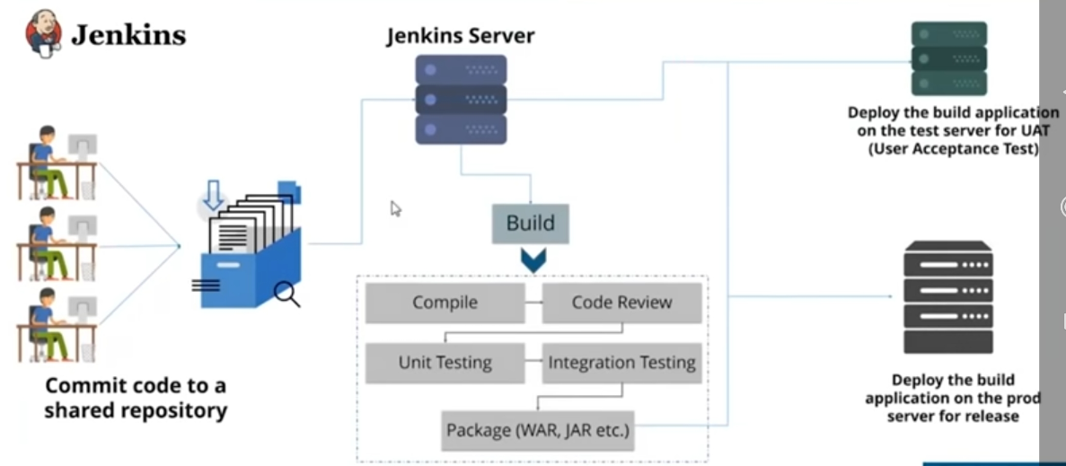
Continuous Deployment
Notes:
Is taking the built application that have tested and deploying that into prod servers automatically for release.
It is not good practice to do , we need to take some measures before deploying in prod servers.

Slide 37
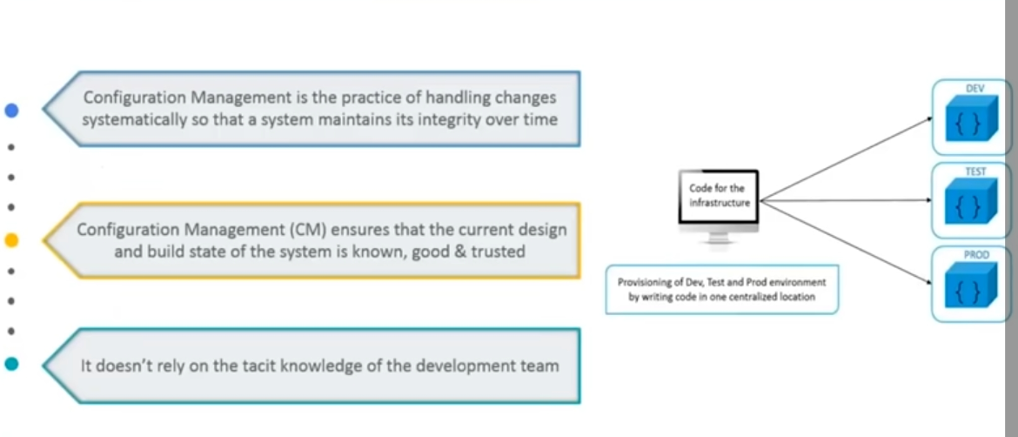
Configuration Management
Notes:
Issues of Deployment - because of dependencies mismatch app is not working in prod
Infrastructure as a code

Slide 38
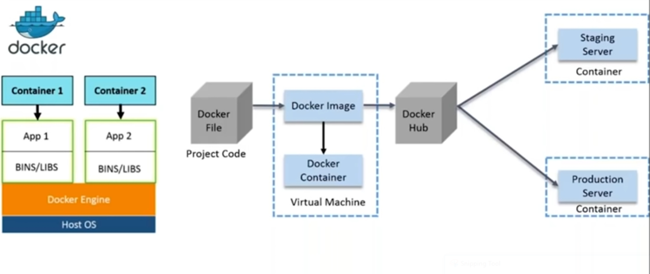
Containerization
Docker is a container management service. The keywords of Docker are develop, ship and run anywhere. The whole idea of Docker is for developers to easily develop applications, ship them into containers which can then be deployed anywhere.
Notes:
Light weight alternative to virtual machines.
Contains binaries and libraries required for an application. We don’t have Host OS.

Slide 39
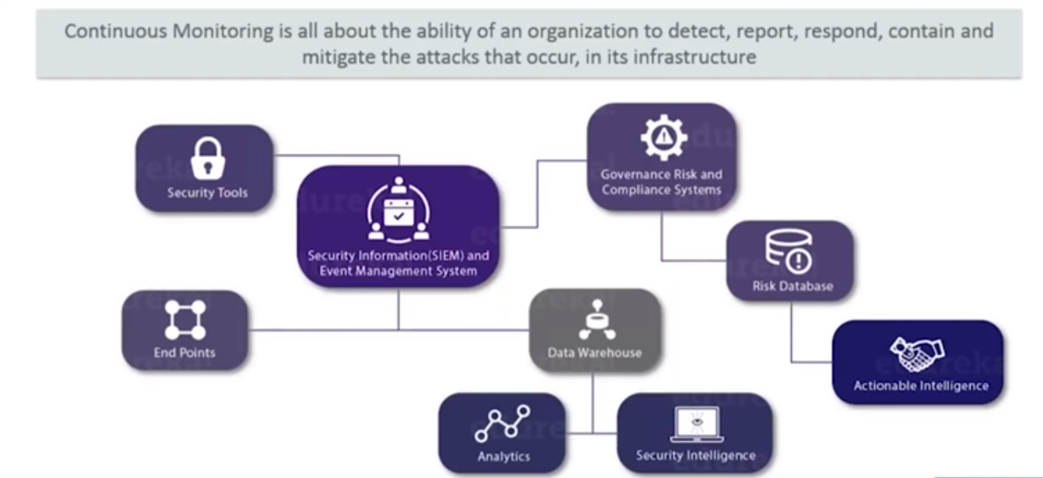
Continuous Monitoring
Notes:
Its an integration of organization security tools , aggregation , normalization and co-relation of the data that is produced by security tools.
Resolves system errors – low memory and unreachable server.

Slide 40
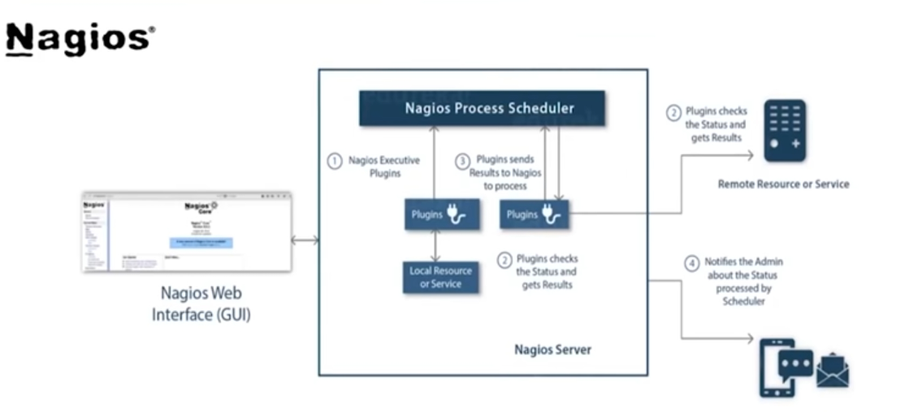
Continuous Monitoring

Slide 41
DevOps Engineer Skills
Skills Every DevOps Engineer Must Have
Flexibility Coding is an ongoing process & always needs to be updated
Security Skills
skilled areas security is always of the utmost importance
Collaboration
Scripting Skills
Decision-making
Infrastructure Knowledge
Soft Skills

Slide 42
Recap
Waterfall Model
Agile Method
DevOps
DevOps Stages
Source Code Management
Continuous Integration
Continuous Delivery
Continuous Deployment
Configuration Management
Continuous Monitoring

Slide 43

Thank you

